Slide 1
Errors in statistical testing and differential gene expression
Week 4, Computational Genomics
Notes:
Goal: Statistical testing is imperfect, why it is imperfect, and what we can do to address it, especially when we run many statistical tests.

Slide 2
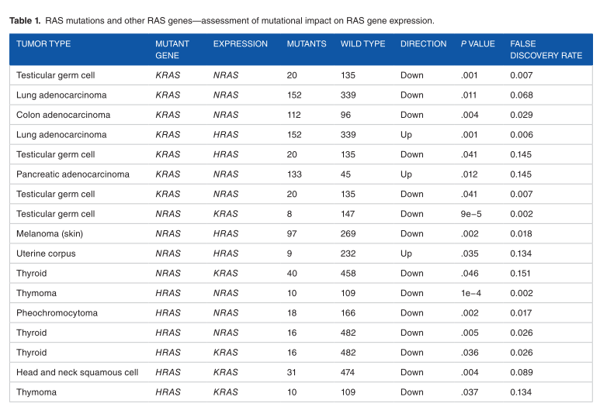
What should we consider when we make many statistical tests?
Notes:
Table 1 from KRAS paper.
The authors conducts t-tests of other -RAS family genes to see whether -RAS mutation is association with -RAS expression level.
HRAS and NRAS are virtually identical as KRAS, except several amino acid changes near the C-terminus of the protein. All expressed in most healthy cells.
Biologically, perhaps a -RAS mutation is signaling other -RAS proteins.
60 or so tests done.
If it the test is not perfect, then we are going to have issues when we make many statistical tests.

Slide 3
Statistical testing is imperfect
Suppose that the null hypothesis is spot on: at the population level, the different in mean gene expression between WT and MT is 0: population parameter = null hypothesis.
What do you expect a perfect statistical test to say?
Notes:
Review: what are the steps in hypothesis testing?

Slide 4
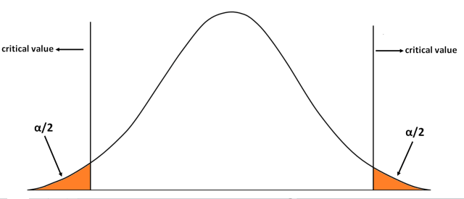
Statistical testing is imperfect
Suppose that the null hypothesis is spot on: at the population level, the different in mean gene expression between WT and MT is 0: population parameter = null hypothesis.
Then, giving a sampling distribution of null hypothesis, a p-value cutoff of 5%, and a sample statistic (which also comes from the sampling distribution),
How likely will we reject the sample statistic?
Notes:
What proportion of the sample statistic will be rejected?

Slide 5
[demo]

Slide 6
This is known also known as the false positive rate:
the probability of false statistical significance.
rejecting the null hypothesis when one should not.
positive = statistical significance, reject null hypothesis.
Notes:
Careful about terminology: positive = rejecting null hypothesis. (as in, positive = statistical significance) False positive = rejecting null hypothesis when one should not.
Careful about terminology: negative = accepting null hypothesis (as in, negative = statistical insignificance). False negative = not rejecting null hypothesis when one should reject.
What are other examples of statistical tests that we care about its false positives?
Whether a gene’s expression is different between MT and WT.
Whether a vaccine has benefits.
Whether a patient’s tumor biopsy is positive for cancer.
----
Rejecting the null hypothesis does not necessarily mean that the null hypothesis is false.
Failing to reject the null hypothesis does not mean the null hypothesis is true.
This is due to chance and sample size.

Slide 7
This is known also known as the false positive rate:
the probability of false statistical significance.
rejecting the null hypothesis when one should not.
Positive = statistical significance, reject null hypothesis.
There is also the false negative rate:
the probability of false statistical insignificance.
not rejecting the null hypothesis when one should reject.
negative = statistical insignificance, favors null hypothesis.
Notes:
What are other examples of statistical tests that we care about its false positives/negatives?
Whether a gene’s expression is different between MT and WT.
Whether a vaccine has benefits.
Whether a patient’s tumor biopsy is positive for cancer.

Slide 8
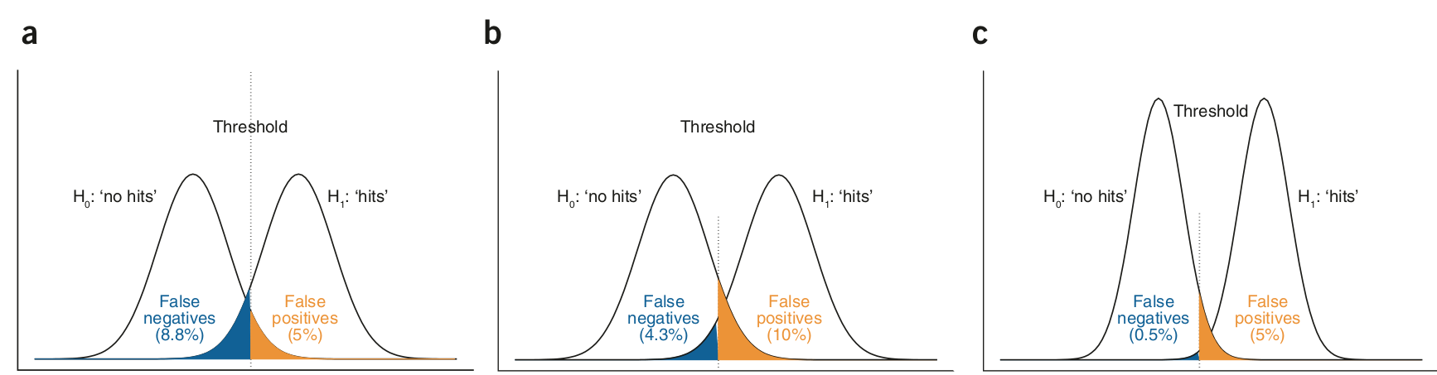
Statistical testing is imperfect
Notes:
Now, we return to the theoretical demo.
The first peak is the scenario where the null hypothesis is spot on: the null hypothesis is the true population parameter. We worry about false positives.
The second peak is the scenario where the null hypothesis is not spot on. The sample statistic come from a different sampling distribution of the population parameter, where the population parameter is different. What proportion of the sample statistic will be rejected? We worry about false negatives: what proportion of this sampling distribution of the population parameter falls into the threshold of not rejecting the null hypothesis?

Slide 9
Statistical testing is imperfect
Notes:
False positives are fixed by the p value cutoff, but false negatives depends on several factors

Slide 10
Statistical testing is imperfect
Notes:
Ways to change FN rate: sample size, and what the difference is between the true population parameter and the null hypothesis.
way to change FP rate: p-value cutoff - FPs are only in the context of when the population parameter is the null hypothesis.
Does anyone want to walk through this in the case the null hypothesis is spot on, and when the null hypothesis isn’t?

Slide 11
Ways to change False Positive rate: p-value cutoff.
Ways to change False Negative rate: p-value cutoff, population effect size, and sample size. More samples -> smaller false negative rate.

Slide 12
Errors in statistical testing summarized
population
 | Accept null hypothesis | Reject null hypothesis
Test accepts null hypothesis | True negative rate | False negative rate
Test rejects null hypothesis | False positive rate | True positive rate
test
Positive = statistical significance, reject null hypothesis.
Negative = no statistical significance, favor null hypothesis.

Slide 13
Errors in statistical testing summarized
population
 | Accept null hypothesis | Reject null hypothesis
Test accepts null hypothesis | True negative rate 1 - P-value cutoff | False negative rate 1 - Power
Test rejects null hypothesis | False positive rate P-value cutoff | True positive rate Power
test
Power = “What is the probability of detecting statistical significance when null hypothesis should be rejected?”
Power is computed by sample size, population effect size, and p-value cutoff.
Notes:
When the null hypothesis is false, we need to know something about the population true parameter (effect size) in order to make the power calculation.

Slide 14
How are these errors useful in practice?
False positive rate is fixed by p-value cutoff: 5% of our positive results are false.
False negative rate is not fixed: We did not see x% of significant results because we didn’t call them statistically significant. We don’t know how to compute it because we don’t know the population effect size.
Notes:
I have shown you that statistical errors exist, what kind of errors are there, and the sources of these errors. Now, how are they useful in practice?

Slide 15
How are these errors useful in practice?
Often, before we run an analysis, we calculate power assuming a population effect size to ballpark our results: What is the probability of detecting statistical significance when null hypothesis should be rejected?
“If desired effect size is 1 log fold change, and I have 50 MT and 50 WT samples, what is the power of the test?”
https://www.statskingdom.com/32test_power_t_z.html

Slide 16
How are these errors useful in practice?
Often, before we run an analysis, we calculate power assuming a population effect size to ballpark our results: What is the probability of detecting statistical significance when null hypothesis should be rejected?
“If desired effect size is 1 log fold change, and I have 50 MT and 50 WT samples, what is the power of the test?”
https://www.statskingdom.com/32test_power_t_z.html
How do we interpret our analysis if power is low? high?
Notes:
What are other examples of statistical tests that we care about its false positives?
Whether a gene’s expression is different between MT and WT.
Whether a vaccine has benefits.
Whether a patient’s tumor biopsy is positive for cancer.

Slide 17
Differential gene expression - what’s the issue?
Suppose that you test for difference of gene expression using the T-test, starting with just one gene.
What is the expected number of false positives you will get if you test 100 genes? 1000 genes? 20,000 genes?
Notes:
5
50
1,000
In this case, it is hard to say because some genes are truly differentially expressed, and some are not. The upper bound of false positives is to assume that all genes are not diff. exp., leading to the most number of false positives.

Slide 18
[demo]
Notes:
Introduce: Familywise error rate, False Discovery Rate

Slide 19
Summary of p-value adjustment methods
No adjustment: p-value controls for a single false positive in one test.
Familywise Error Rate: make p-value threshold more strict by allowing for a single false positive out N tests.
False Discovery Rate: adjusted p-value controls for a single false positive out of the positive tests.

Slide 20
Back to our original question

Slide 21

Multiple testing when there is definitely no effect
Notes:
Even if you make your statistical corrections, there is still error, and we need to think beyond the single number.
http://prefrontal.org/files/posters/Bennett-Salmon-2009.pdf

Slide 22
p-values and scientific reproducibility
If our statistical analysis is imperfect, they are cheap and easy to do, and we have professional incentive to find new, exciting results, what could possibly go wrong?
Notes:
https://www.youtube.com/watch?v=FpCrY7x5nEE
“There’s not enough power; let’s run another test on something else.”

Slide 23
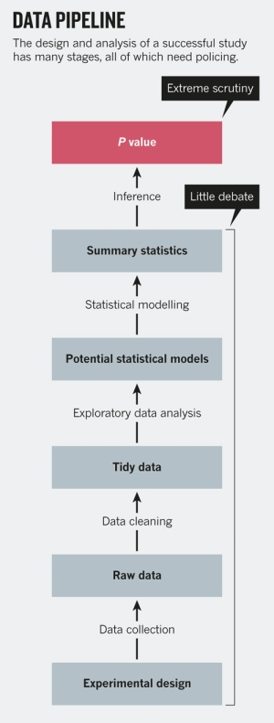
Notes:
https://www.nature.com/news/statistics-p-values-are-just-the-tip-of-the-iceberg-1.17412 - JHU biostats
P values are an easy target: being widely used, they are widely abused. But, in practice, deregulating statistical significance opens the door to even more ways to game statistics — intentionally or unintentionally — to get a result. Replacing P values with Bayes factors or another statistic is ultimately about choosing a different trade-off of true positives and false positives. Arguing about the P value is like focusing on a single misspelling, rather than on the faulty logic of a sentence.
Better education is a start. Just as anyone who does DNA sequencing or remote-sensing has to be trained to use a machine, so too anyone who analyses data must be trained in the relevant software and concepts. Even investigators who supervise data analysis should be required by their funding agencies and institutions to complete training in understanding the outputs and potential problems with an analysis.

Slide 24
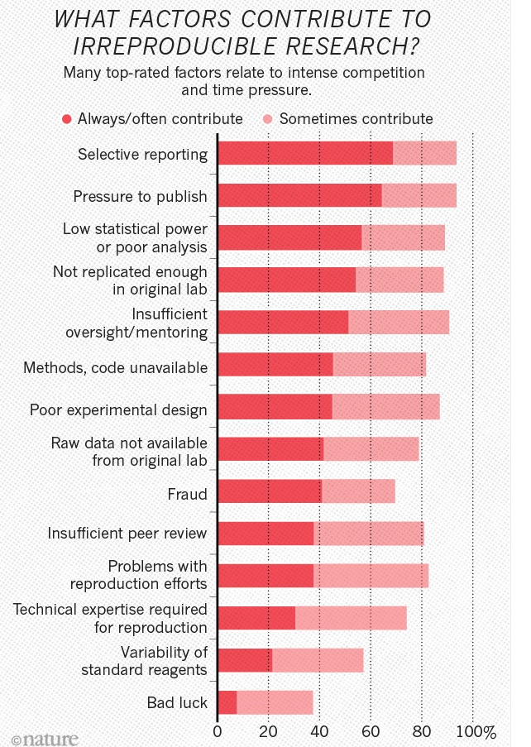
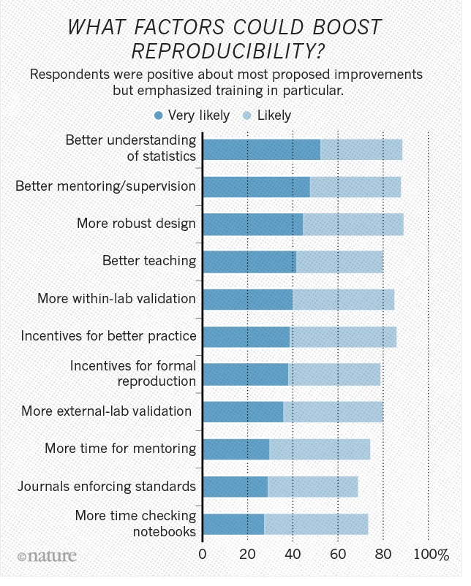
Notes:
More than 70% of researchers have tried and failed to reproduce another scientist's experiments, and more than half have failed to reproduce their own experiments. Those are some of the telling figures that emerged from Nature's survey of 1,576 researchers who took a brief online questionnaire on reproducibility in research.
The data reveal sometimes-contradictory attitudes towards reproducibility. Although 52% of those surveyed agree that there is a significant 'crisis' of reproducibility, less than 31% think that failure to reproduce published results means that the result is probably wrong, and most say that they still trust the published literature.
https://www.nature.com/news/1.19970

